Slide 1

S3 REPLICATION USING LAMBDA
Team Members:
P D Sai Rama Krishna -20551A04G6
R Vennela - 20551A04G8
K Jagadeesh - 21555A0419
Y L S Adithya Sai - 20551A04H9
Godavari institute of engineering and technology-GIER

Slide 2
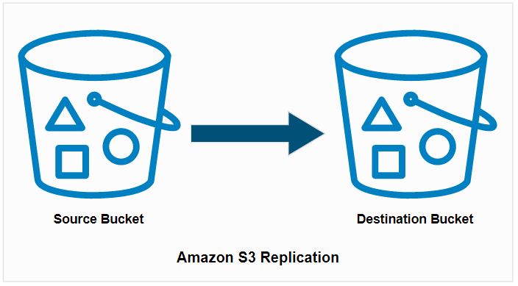
Abstract :
The project involves setting up an automated S3 bucket replication system using AWS Lambda. The goal is to keep two S3 buckets in sync so that whenever a file is uploaded to the first bucket, it is automatically copied and updated in the second bucket.

Slide 3
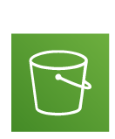


Architecture :
¦
¦
＋
Files Uploaded to Destination Bucket
¦
Destination Bucket
Copy Function Invokes
↑
¦
Upload file
↑
↑
↑
Source Bucket
aws Lambda
IAM role

Slide 4
Used Services:
1.S3 (Simple storage service)
2.AWS Lambda
3.IAM(Identification And Access management)
IAM role
S3 Bucket
aws Lambda

Slide 5
Process Overview :
1. Set up two S3 Buckets:
- Bucket 1: Source Bucket
- Bucket 2: Destination Bucket
2. Create an IAM Role:
- An IAM role needs to be created with the appropriate permissions to allow the Lambda function to access both S3 buckets. The role should have permissions for reading from the source bucket and writing to the destination bucket.
3. Create an AWS Lambda Function:
- The Lambda function will be responsible for handling the replication process. When triggered, it will read the uploaded file from the source bucket and copy it to the destination bucket.

Slide 6
4. Configure S3 Event Notification:
- An event notification should be configured on the source bucket to trigger the Lambda function whenever a new file is uploaded or an existing file is updated.
5. Implement Lambda Function Logic:
- The Lambda function should be written to handle the event triggered by the S3 bucket. When invoked, it should retrieve the object (file) details from the event and copy it to the destination bucket.
6. Testing and Monitoring:
- After setting up the replication process, it's essential to thoroughly test the system to ensure that files are being correctly replicated from the source bucket to the destination bucket

Slide 7
Applications :
S3 replication has numerous applications in various industries and scenarios, all aimed at ensuring data availability, durability, and disaster recovery. Here are main applications of S3 replication:
Disaster Recovery and Business Continuity
Data Redundancy
Data Durability

Slide 8
CONCLUSION
By successfully implementing the "Automatic S3 Bucket Replication using AWS Lambda" project, we establish an efficient and automated data replication system. Files uploaded to the source bucket are seamlessly and promptly copied to the destination bucket, ensuring data redundancy, disaster recovery, and data availability. AWS Lambda simplifies the replication process, and IAM roles guarantee secure access control.

Slide 9
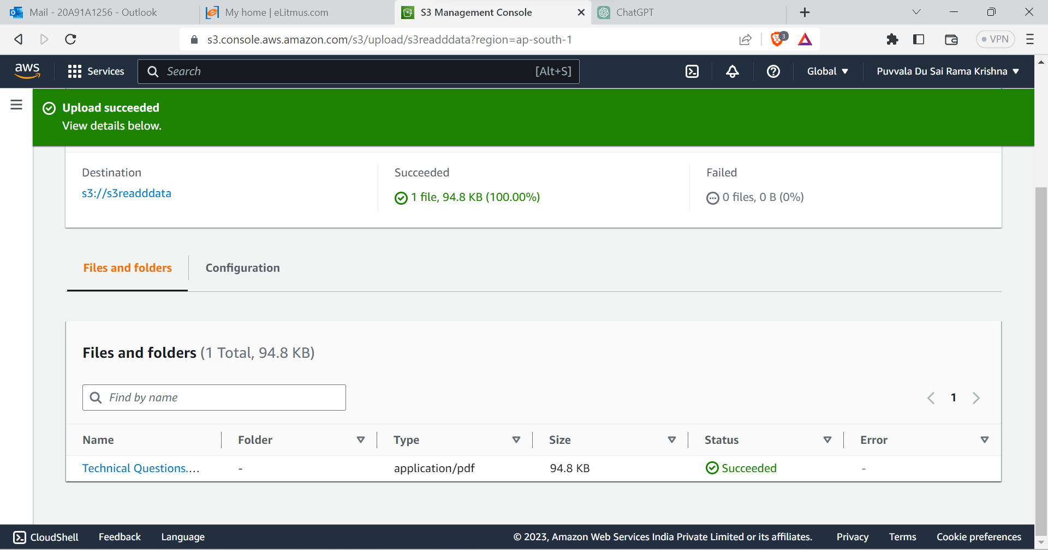
RESULT

Slide 10
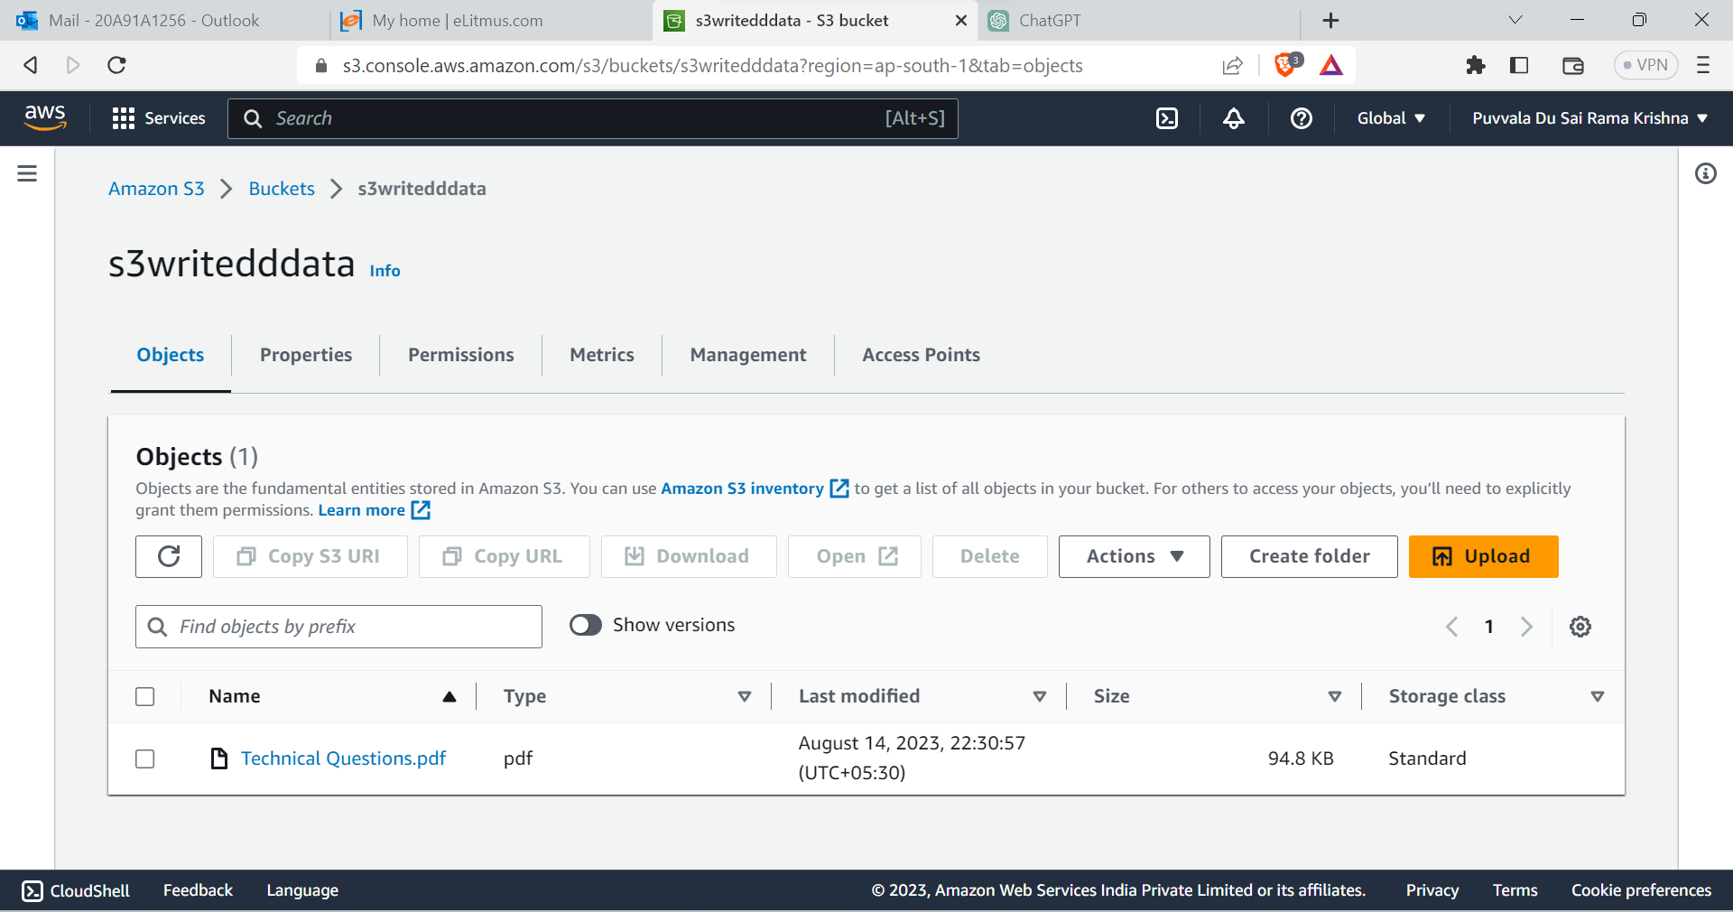

Slide 11


